Slide 1
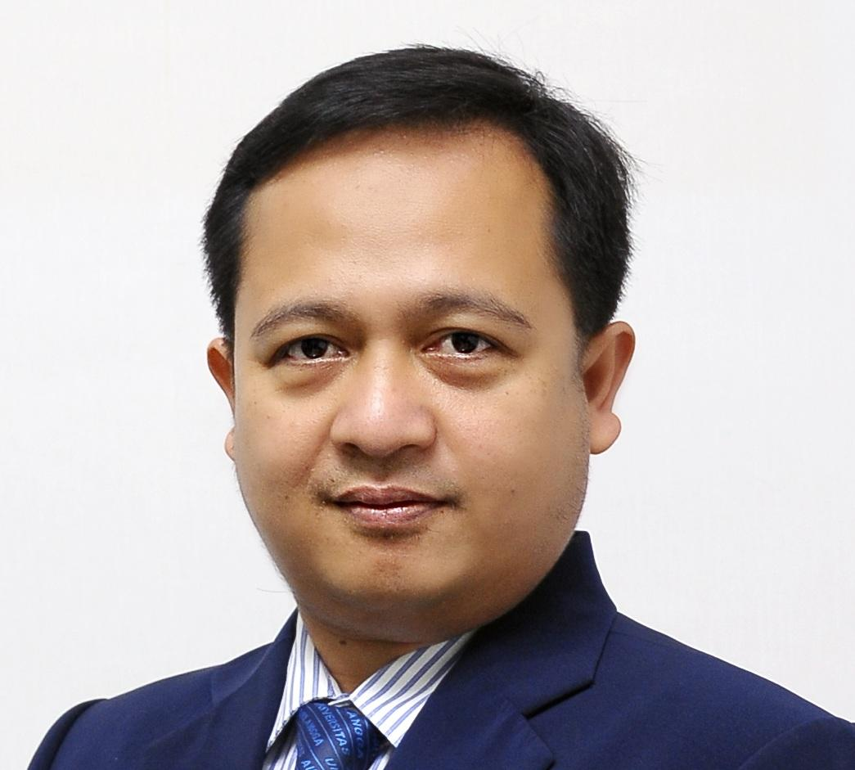
“Integration of Waqf into Green or Blue
Financing Framework”
Presented on :
Islamic Economics Winter Course (IESWC) IPB University
September 14, 2023
Prof. Raditya Sukmana SE., MA.
Coordinator of Islamic Economic Doctoral Program
Faculty of Economic and Business, Universitas Airlangga

Slide 2
Outline of this Presentation
1
2
WAQF
Sukuk
a - Waqf Importance
b - Green Waqf Model
a - State Sukuk
b - Retail Green Sukuk
3
Integration of Waqf & Green Financing (a proposal model)
*also for Blue Finance

Slide 3
WAQF

Slide 4
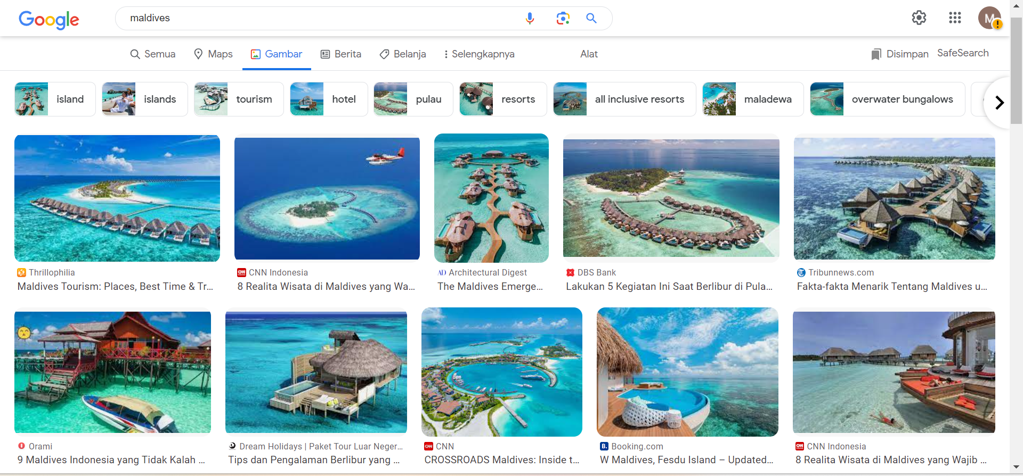
1a - Waqf Importance
What is the first thing that comes to mind when discussing "Maldives" "??
The beauty? The tourism? The blue beach?

Slide 5
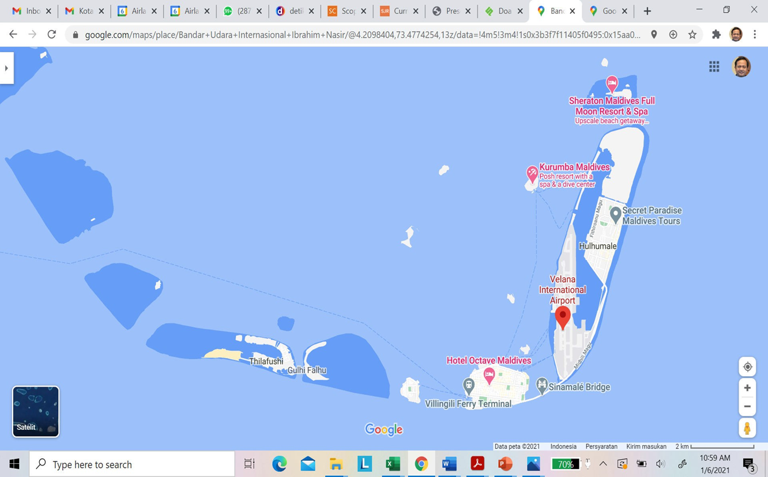
1a - Waqf Importance
Maldives Map

Slide 6

1a - Waqf Importance

Slide 7
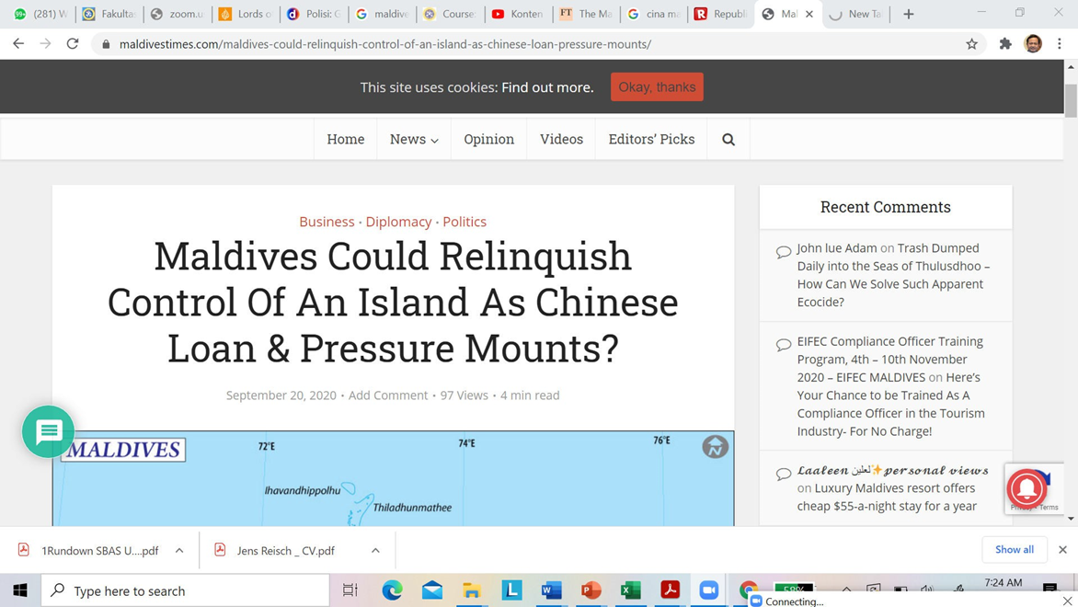
1a - Waqf Importance

Slide 8
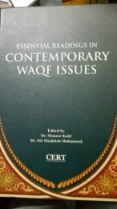
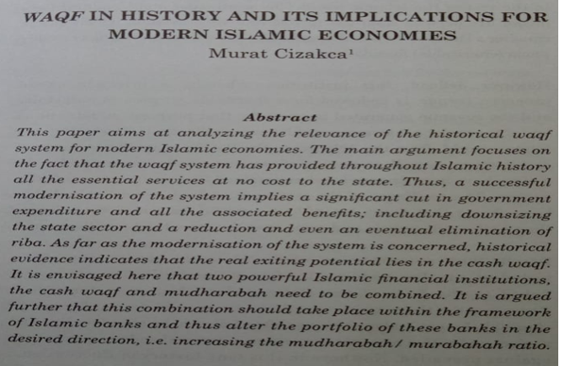
1a - Waqf Importance
How can Waqf reduce RIBA?

Slide 9
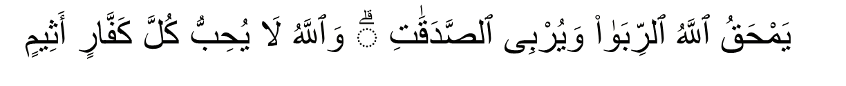
1a - Waqf Importance
Lessons from the Maldives
Allah destroys usury and enriches charity. Allah does not like anyone who remains in disbelief and wallows in sin. (Qs. Al-Baqarah (2): 276)

Slide 10
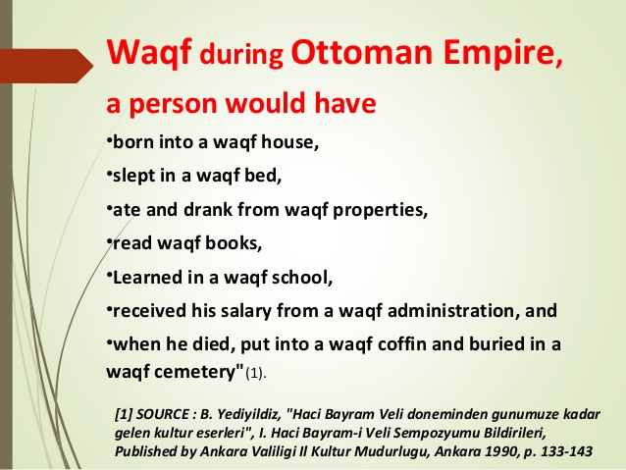
1a - Waqf Importance
Living on Waqf

Slide 11

1b - Green Waqf Model
Green Waqf itself is defined as the utilization of a waqf asset to support the attainment of ecological balance and sustainability, while also providing a social and economic impact for society.
This Green Waqf framework is developed by the Indonesia Waqf Board (BWI) in collaboration with United Nations Development Programme (UNDP-lndonesia), Waqf Center for Indonesian Development and Studies (WaCIDS), and Green Waqf Organization

Slide 12
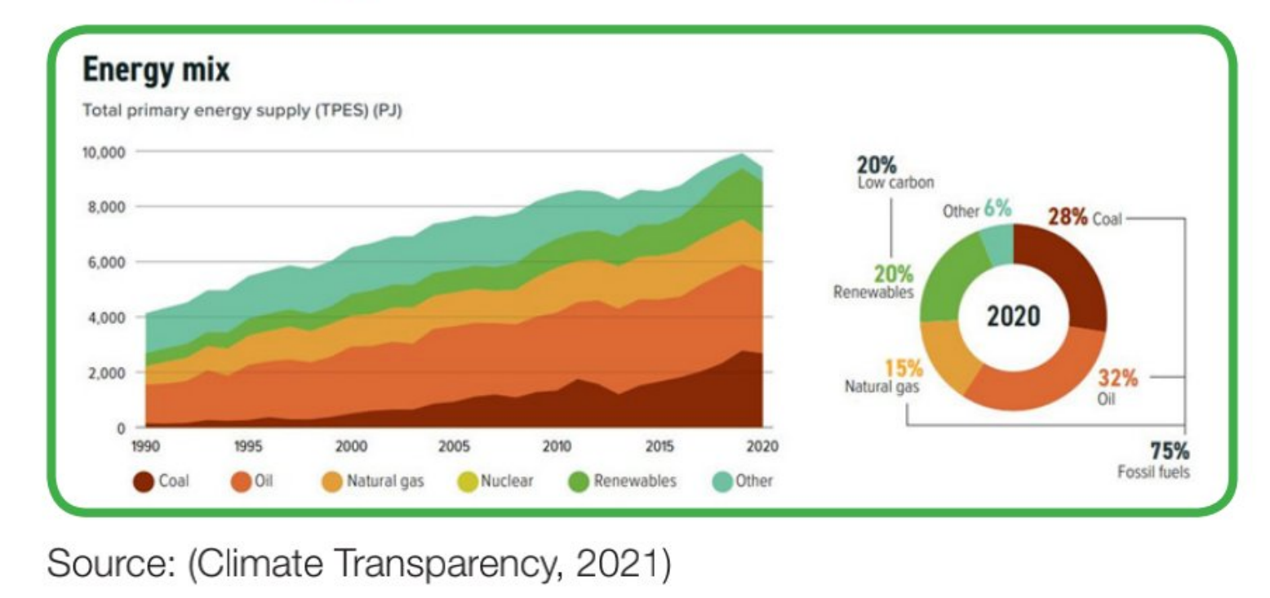
1b - Green Waqf Model
What’s Problem on Environment?
Energy Mix

Slide 13
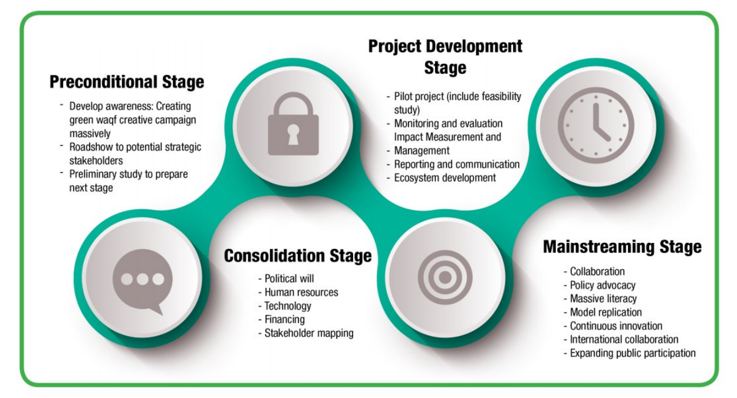
1b - Green Waqf Model
Proposed Stages for Green Waqf Initiative

Slide 14
Sukuk

Slide 15
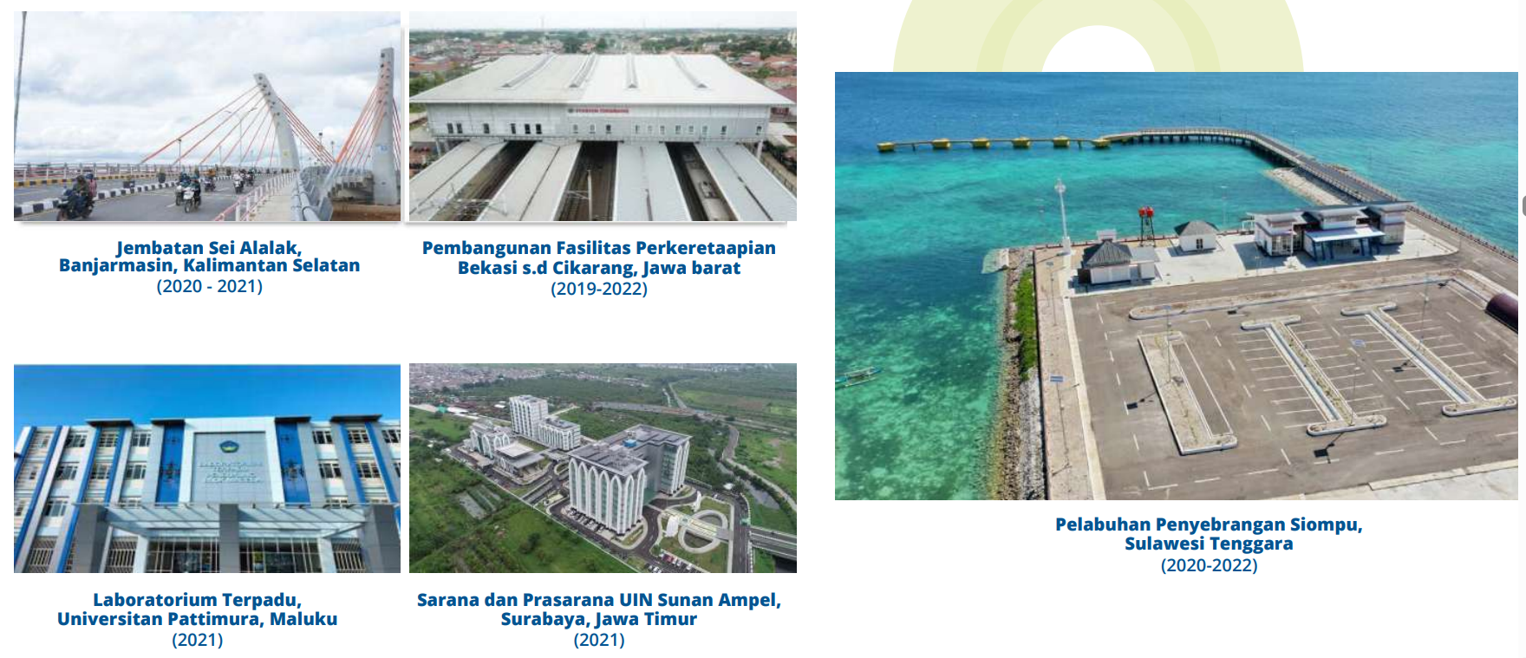
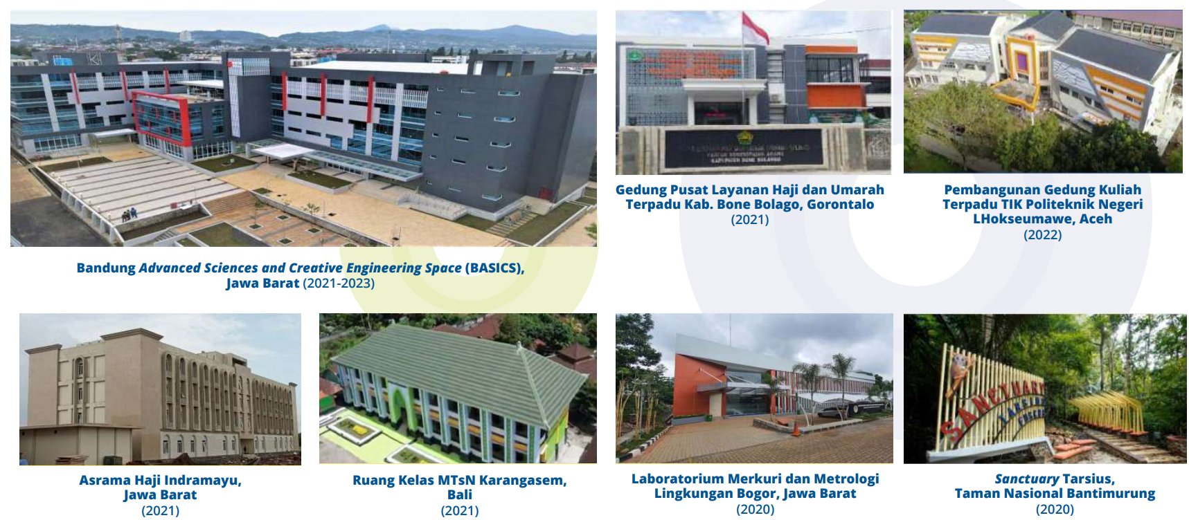
2a - State Sukuk
Utilization of State Sukuk
Sukuk issued by the Indonesian government are utilized for the construction of facilities such as:
- transportation companies (shipping, railroad)
- Education infrastructure facilities (University & school)
- building public service facilities
- others
Notes:
Pg. 70-71

Slide 16
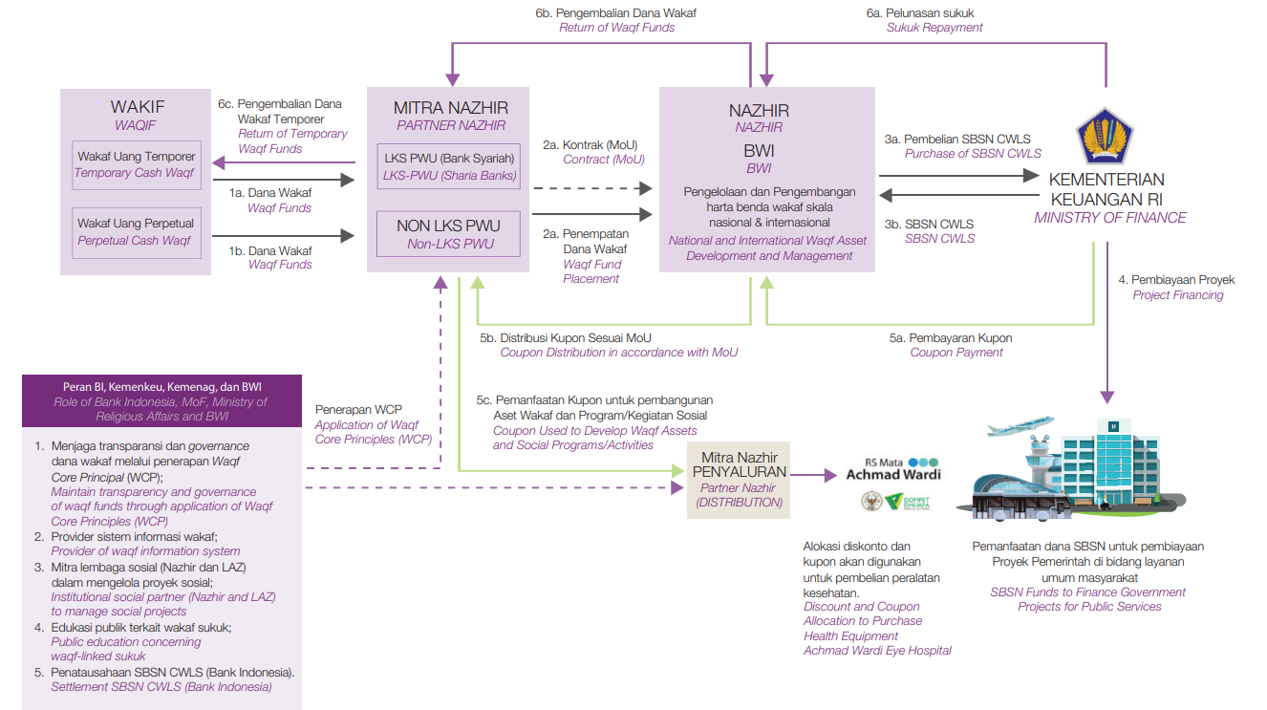
2a - State Sukuk
CWLS Scheme
Source : Annual Report CWLS (2021)
Notes:
Pg. 33

Slide 17
2a - State Sukuk
Advantages CWLS
1
2
3
SAFE
TRUSTED
SIMPLE
Cash waqf placements in investment instrument guaranteed by the state
Transparent and accountable cash waqf fund management and utilisation
Cash waqif facilities are available to enable utilisation for product activities
4
5
6
PRODUCTIVE
INTACT
BLESSED
Returns paid monthly and utilised to fund social programs/activities and public empowerment
100% of the funds are returned to the waqif (temporary)/nazhir upon SBSN maturity
A minimum Rp. 1 million investment brings jariyah blessings
Source : Annual Report CWLS (2021)
Notes:
pg. 46

Slide 18
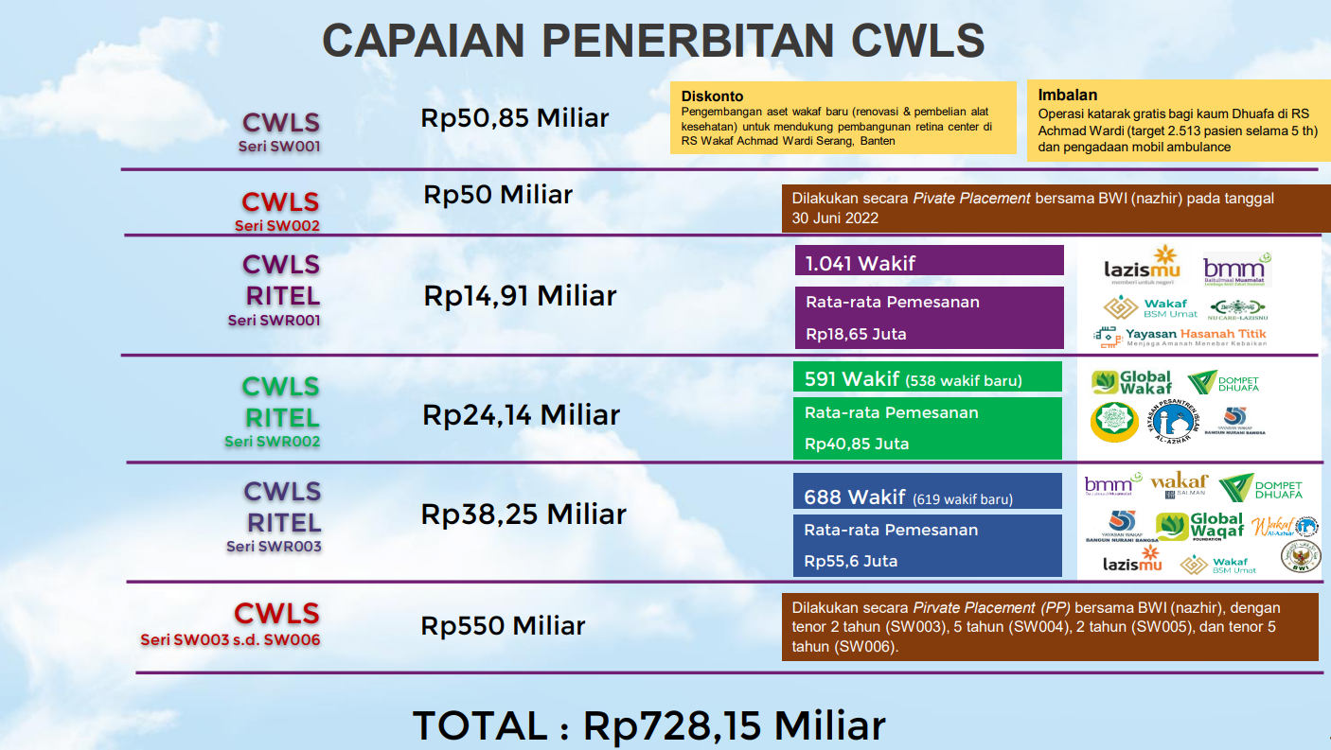
2a - State Sukuk

Slide 19

2b - Retail Green Sukuk
Green sukuk are state sharia securities whose issuance proceeds are used to finance projects that fall into the "sustainable projects" category.
In line with the government's commitment to achieving sustainable development and climate change goals.
Green sukuk is one solution to support sustainable financing innovation that implements environmental, social and governance aspects.

Slide 20
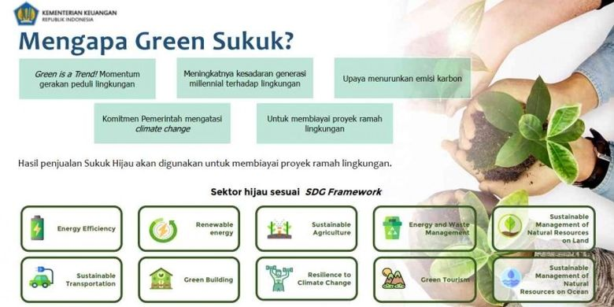
2b - Retail Green Sukuk
Why Green Waqf?
Green is a trend! The right time for the environmental care movement
Increasing awareness of the millennial generation towards the environment
Efforts to reduce carbon emissions
The government's commitment to addressing climate change
Efforts to finance environmentally friendly projects
The proceeds from the sale of green sukuk will be used to finance environmentally friendly projects. The green sector according to the SDG Framework is:

Slide 21

3 - Integration Waqf & Green Financing
Integrating Waqf into Green & Blue Financing Framework (A proposal)

Slide 22
3 - Integration Waqf & Green Financing
Waqf & Sharia Capital Market?
As an effort to encourage the use of sharia capital market products
Management of waqf assets to make them more productive
Sumber : KemenKeu RI (2022)

Slide 23

3 - Integration Waqf & Green Financing
Integrating waqf (Islamic endowment) into green or blue financing frameworks can be a powerful way to promote sustainability and support environmental and social projects.
Waqf involves dedicating assets or funds to charitable or public welfare purposes, and it can align well with green and blue financing objectives.

Slide 24
3 - Integration Waqf & Green Financing
Steps integrate waqf into green or blue financing frameworks:
1
2
Educate Stakeholders
Identify Suitable Waqf Assets
Raise Awareness about the concept of green and blue financing and how it aligns with Islamic principles and values.
Determine which waqf assets can be used to support green or blue projects. These assets could include land, real estate, cash donations, or other valuable resources.
3
4
Engage Local Communities
Collaborate with Islamic Financial Institutions
Involve local communities in the decision-making process for selecting and implementing green or blue projects funded by waqf. This can help ensure that projects address local needs and concerns.
Collaborate with Islamic banks and financial institutions that specialize in green or blue financing.
Develop Waqf-Linked Investment Products, (e.g., sukuk or bonds) that are linked to waqf funds and are dedicated to green or blue projects. These products should adhere to Islamic financial principles.

Slide 25
3 - Integration Waqf & Green Financing
Steps integrate waqf into green or blue financing frameworks:
5
6
Ensure Compliance
Awareness Campaigns
Ensure that the waqf-linked financial products and investments comply with both Islamic finance principles and the regulatory framework governing green or blue financing.
Promote awareness about the concept of sustainable waqf, encouraging more individuals and organizations to contribute to these funds.
7
8
Legal Documentation
Impact Evaluation
Create clear legal documents outlining the terms and conditions of the waqf, including how funds will be used for green or blue financing, and how they will be managed and distributed.
Monitor and evaluate the environmental and social impact of the green or blue projects financed through waqf.

Slide 26
3 - Integration Waqf & Green Financing
Innovation Waqf for Green or Blue Financing Project

Slide 27


3 - Integration Waqf & Green Financing
Waqf-Eco Tourism
Developing halal tourism financed with waqf (opening new tourist attractions, opening accommodation, establishing culinary centers, etc.). Waqf land and financing for building
Inviting foreign tourists to come to existing halal tourist attractions
Tourists can also be involved in community activities including visiting places funded by other waqfs (hospitals, schools, universities, etc.)

Slide 28
Green/Blue Sukuk Linked Waqf Issuance
The government issues sukuk linked waqf which supports the preservation of the land and sea environment
The government only funds environmentally friendly programs or natural resource conservation

Slide 29
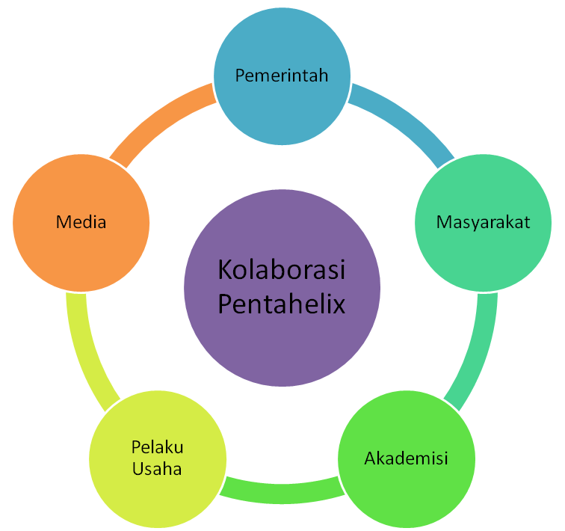
Pentahelix Waqf Ecosystem Development
Increase support for Islamic social funding institutions (LAZNAS, BWI Prov, etc.)
Give appreciation to waqf institutions or waqf collaboration programs that provide broad benefits to the community
Publication of developments and various waqf innovations that attract the attention of the wider community
Increase literacy and update related to waqf
Channeling waqf through a certified waqf institution
Contributing to the success of the waqf program including CSR support to be managed through waqf
Involve students in the MBKM program at waqf institutions
Conducting implementative waqf research
Doing community service on waqf issues

Slide 30
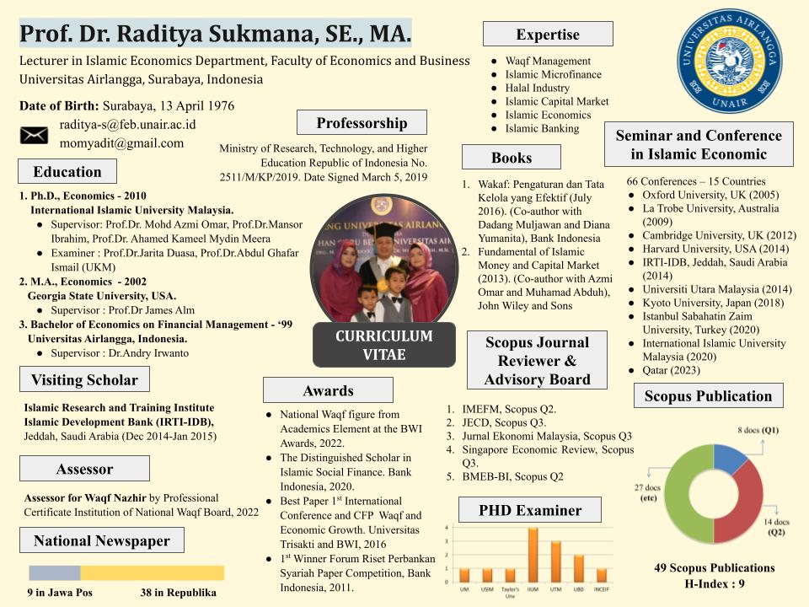
THANK YOU
Notes:
CV terbaru

Slide 31
